Slide 1
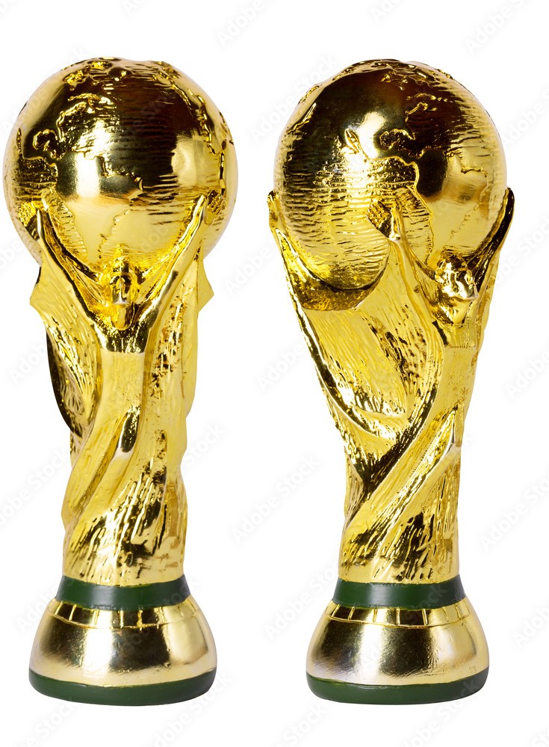

Slide 2

FIFA WORLDCUP PREDICTION SYTEM
BY:
SHIVAM SHARMA
ANKUR RAJ
SUKANTA BHUNIA
UNDER THE GUIDANCE OF:
Ms. Naina and ChatGPT(Majorly)

Slide 3

UNDER THE GUIDANCE OF:
Ms. Naina and ChatGPT(Majorly)
BY:
SHIVAM SHARMA
ANKUR RAJ
SUKANTA BHUNIA

Slide 4


LIST OF CONTENTS
INTRODUCTION
PROJECT ANALYSIS
METHODOLOGY USED
TECHNOLOGY USED
EDA
THE PREDICTION MODEL
THE WEBSITE UI
PROJECT AT A GLANCE

Slide 5
THE
INTRODUCTION

Slide 6

BACKGROUND
In the exhilarating realm where passion meets competition, lies the most celebrated event captivating billions with its breathtaking displays of skill - the FIFA World Cup.
It is a quadrennial spectacle that transcends borders, languages, and cultures, and sheer determination.
As the world holds its breath waiting for the world cup, we present to you our project World Cup Predictor which is going to look at data from around the world to predict the winner of the FIFA World Cup.
FEASIBILITY STUDY
BACKGROUND
Technical Feasibility: The project is implementation based which is technically feasible since we are using python language to code and deploy.
Economic Feasibility: There is no budget constraint for the project as such, which might cause trouble.
Operational Feasibility: Once the project is deployed, the maintenance is quite manageable.
Schedule Feasibility: The timelines/ deadlines for the project have been analyzed and the project will be completed within the time limit.

Slide 7

FEASIBILITY STUDY
Technical Feasibility: The project is implementation based which is technically feasible since we are using python language to code and deploy.
Economic Feasibility: There is no budget constraint for the project as such, which might cause trouble.
Operational Feasibility: Once the project is deployed, the maintenance is quite manageable.
Schedule Feasibility: The timelines/ deadlines for the project have been analyzed and the project will be completed within the time limit.
BACKGROUND
In the exhilarating realm where passion meets competition, lies the most celebrated event captivating billions with its breathtaking displays of skill - the FIFA World Cup.
It is a quadrennial spectacle that transcends borders, languages, and cultures, and sheer determination.
As the world holds its breath waiting for the world cup, we present to you our project World Cup Predictor which is going to look at data from around the world to predict the winner of the FIFA World Cup.

Slide 8
PROJECT
ANALYSIS

Slide 9

MOTIVE
The primary motive behind developing a World Cup win predictor is to combine the thrill of sports with the power of data science and machine learning. By creating accurate predictions for the outcomes of World Cup matches.
The development of a World Cup win predictor bridges the worlds of sports and technology, catering to the excitement of fans while highlighting the capabilities of modern data analysis techniques.

Slide 10
OBJECTIVE
The primary objective of the World Cup Predictor project is to leverage data science and technology to provide accurate match outcome predictions, enrich the experience of football fans, inform strategic decisions, and contribute to the broader understanding of the game's dynamics through data-driven insights.

Slide 11
METHODOLOGY
USED

Slide 12
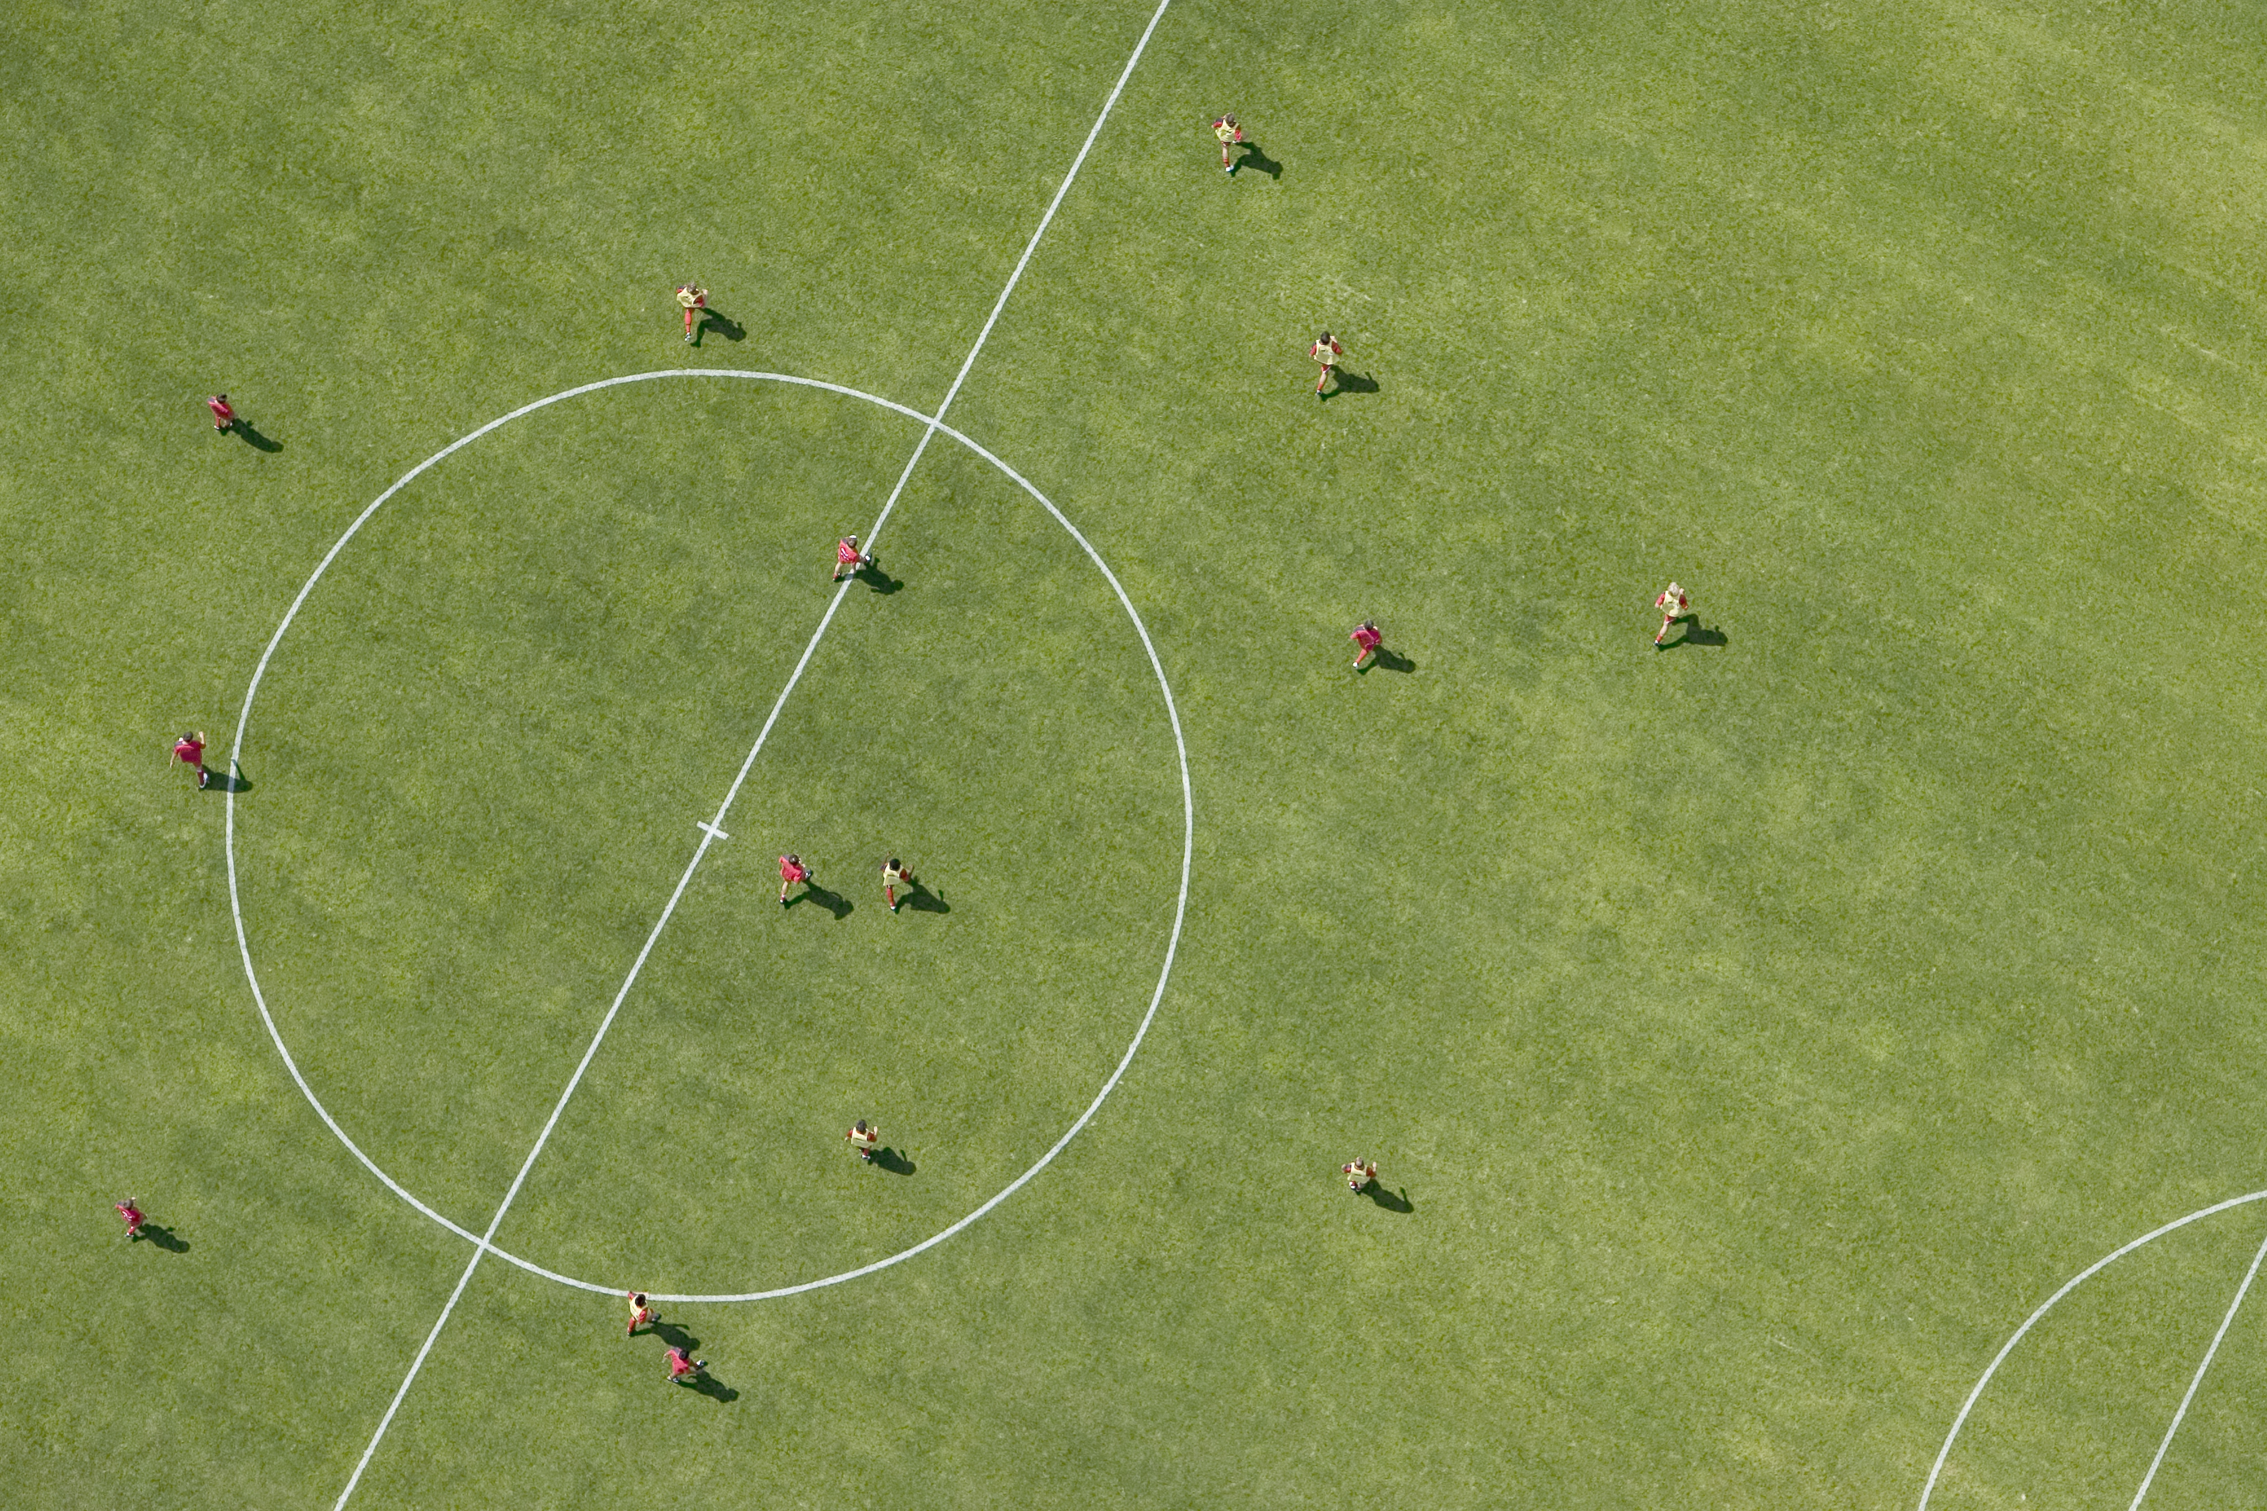
The methodology used in a World Cup prediction project involves:
1. Data Collection
2. Feature Selection
3. Training
4.User Interface
5.Documentation

Slide 13
TECHNOLOGY
USED

Slide 14
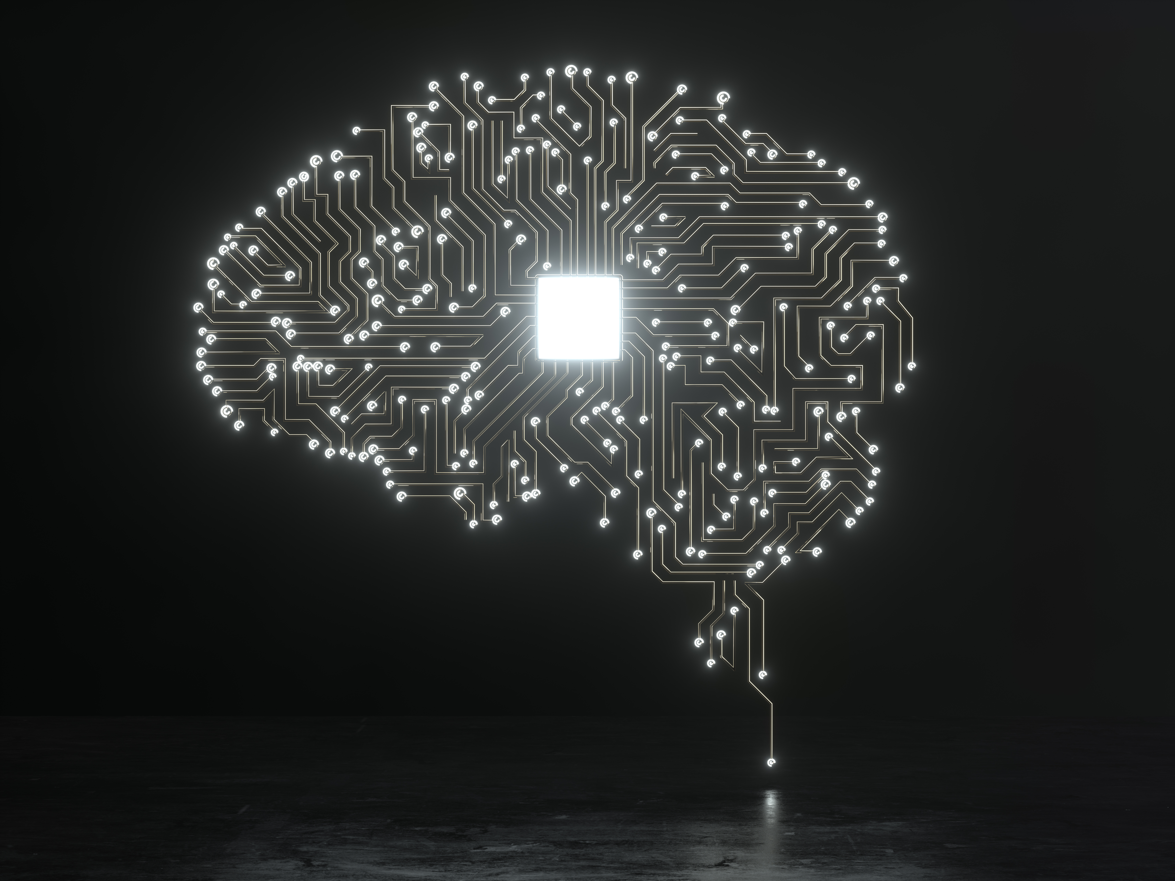

Technologies Used:
1. Programming Languages:
Python: Widely used for data manipulation, analysis, and machine learning.
2. Data Processing and Analysis:
Pandas: A Python library for data manipulation and analysis.
NumPy: Supports arrays and mathematical functions.

Slide 15
Technologies Used:
1. Programming Languages:
Python: Widely used for data manipulation, analysis, and machine learning.
2. Data Processing and Analysis:
Pandas: A Python library for data manipulation and analysis.
NumPy: Supports arrays and mathematical functions.
3. Data Visualization:
Matplotlib: A versatile Python library for creating static, interactive, and animated visualizations.
Seaborn: Built on top of Matplotlib, it provides a higher-level interface for creating attractive statistical visualizations.
Pyplot: Enables creation of interactive visualizations.
4. Real-time Data Integration:
APIs: Utilize APIs provided by sports data providers to access live match updates and player statistics.

Slide 16
Technologies Used:
1. Programming Languages:
Python: Widely used for data manipulation, analysis, and machine learning.
2. Data Processing and Analysis:
Pandas: A Python library for data manipulation and analysis.
NumPy: Supports arrays and mathematical functions.
3. Data Visualization:
Matplotlib: A versatile Python library for creating static, interactive, and animated visualizations.
Seaborn: Built on top of Matplotlib, it provides a higher-level interface for creating attractive statistical visualizations.
Pyplot: Enables creation of interactive visualizations.
4. Real-time Data Integration:
APIs: Utilize APIs provided by sports data providers to access live match updates and player statistics.
5. User Interface and Web Development:
HTML, CSS, JavaScript: For creating a web-based user interface.
Django: Python web frameworks to build the backend of the user interface.
6. Version Control:
Git&Github: To manage and track changes in the project codebase.
7. Testing and Debugging:
Debugging Tools: Like pdb (Python debugger) for identifying
and resolving issues.

Slide 17
Technologies Used:
5. User Interface and Web Development:
HTML, CSS, JavaScript: For creating a web-based user interface.
Django: Python web frameworks to build the backend of the user interface.
6. Version Control:
Git&Github: To manage and track changes in the project codebase.
7. Testing and Debugging:
Debugging Tools: Like pdb (Python debugger) for identifying
and resolving issues.

Slide 18
Technologies Used:
5. User Interface and Web Development:
HTML, CSS, JavaScript: For creating a web-based user interface.
Django: Python web frameworks to build the backend of the user interface.
6. Version Control:
Git&Github: To manage and track changes in the project codebase.
7. Testing and Debugging:
Debugging Tools: Like pdb (Python debugger) for identifying
and resolving issues.
8. IDEs USED:
VS CODE
Jupyter Notebook

Slide 19
EXPLORATOTY
DATA ANALYSIS

Slide 21
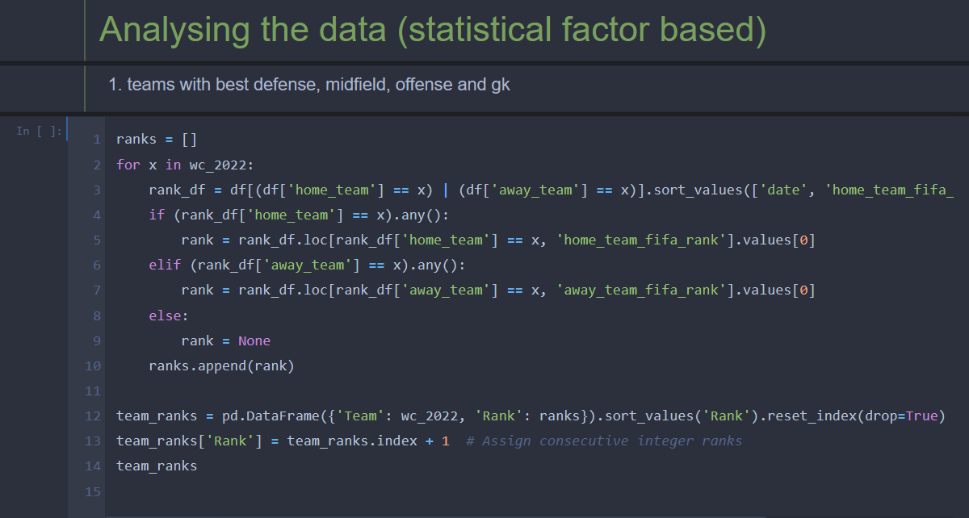

Slide 22
THE PREDICTION
MODEL

Slide 23
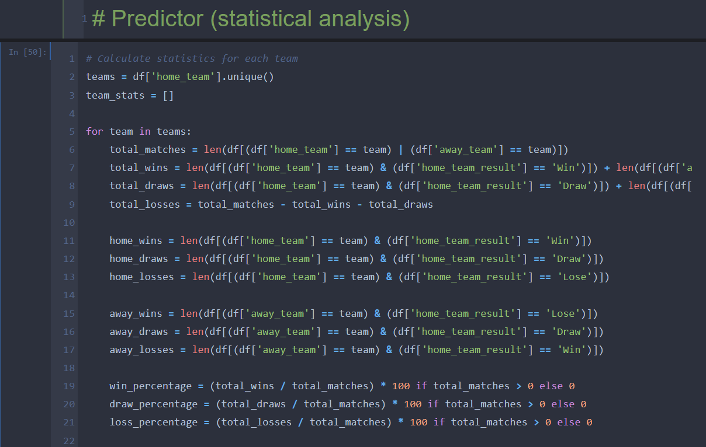
DELIVERABLES
Technical Feasibility: The project is implementation based which is technically feasible since we are using python language to code and deploy.
Economic Feasibility: There is no budget constraint for the project as such, which might cause trouble.
Operational Feasibility: Once the project is deployed, the maintenance is quite manageable.
Schedule Feasibility: The timelines/ deadlines for the project have been analyzed and the project will be completed within the time limit.

Slide 24
DELIVERABLES
Technical Feasibility: The project is implementation based which is technically feasible since we are using python language to code and deploy.
Economic Feasibility: There is no budget constraint for the project as such, which might cause trouble.
Operational Feasibility: Once the project is deployed, the maintenance is quite manageable.
Schedule Feasibility: The timelines/ deadlines for the project have been analyzed and the project will be completed within the time limit.

Slide 25
THE
WEBSITE UI

Slide 26

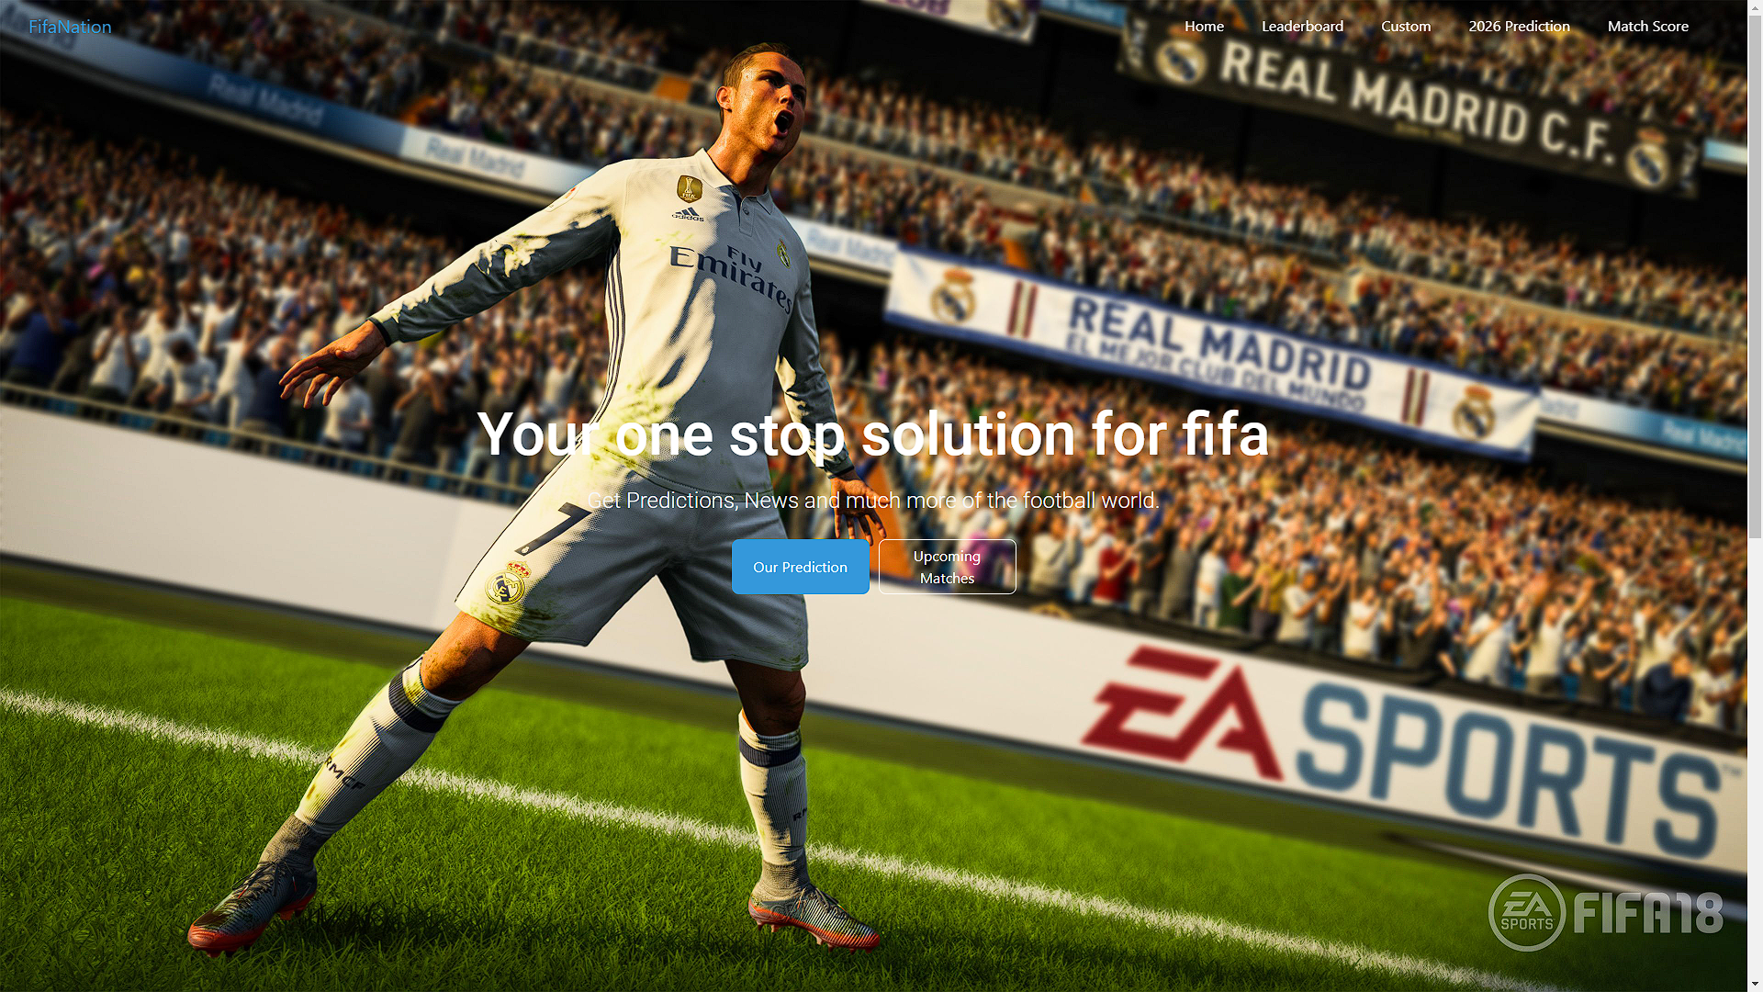

Slide 28
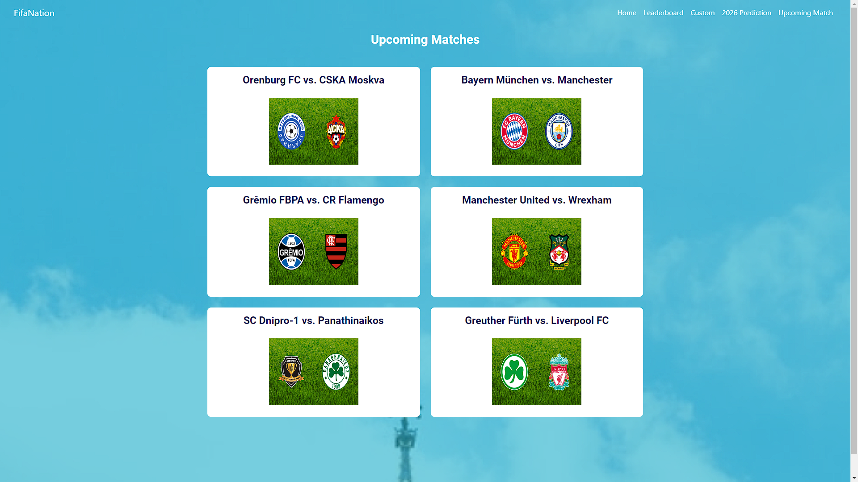

Slide 29
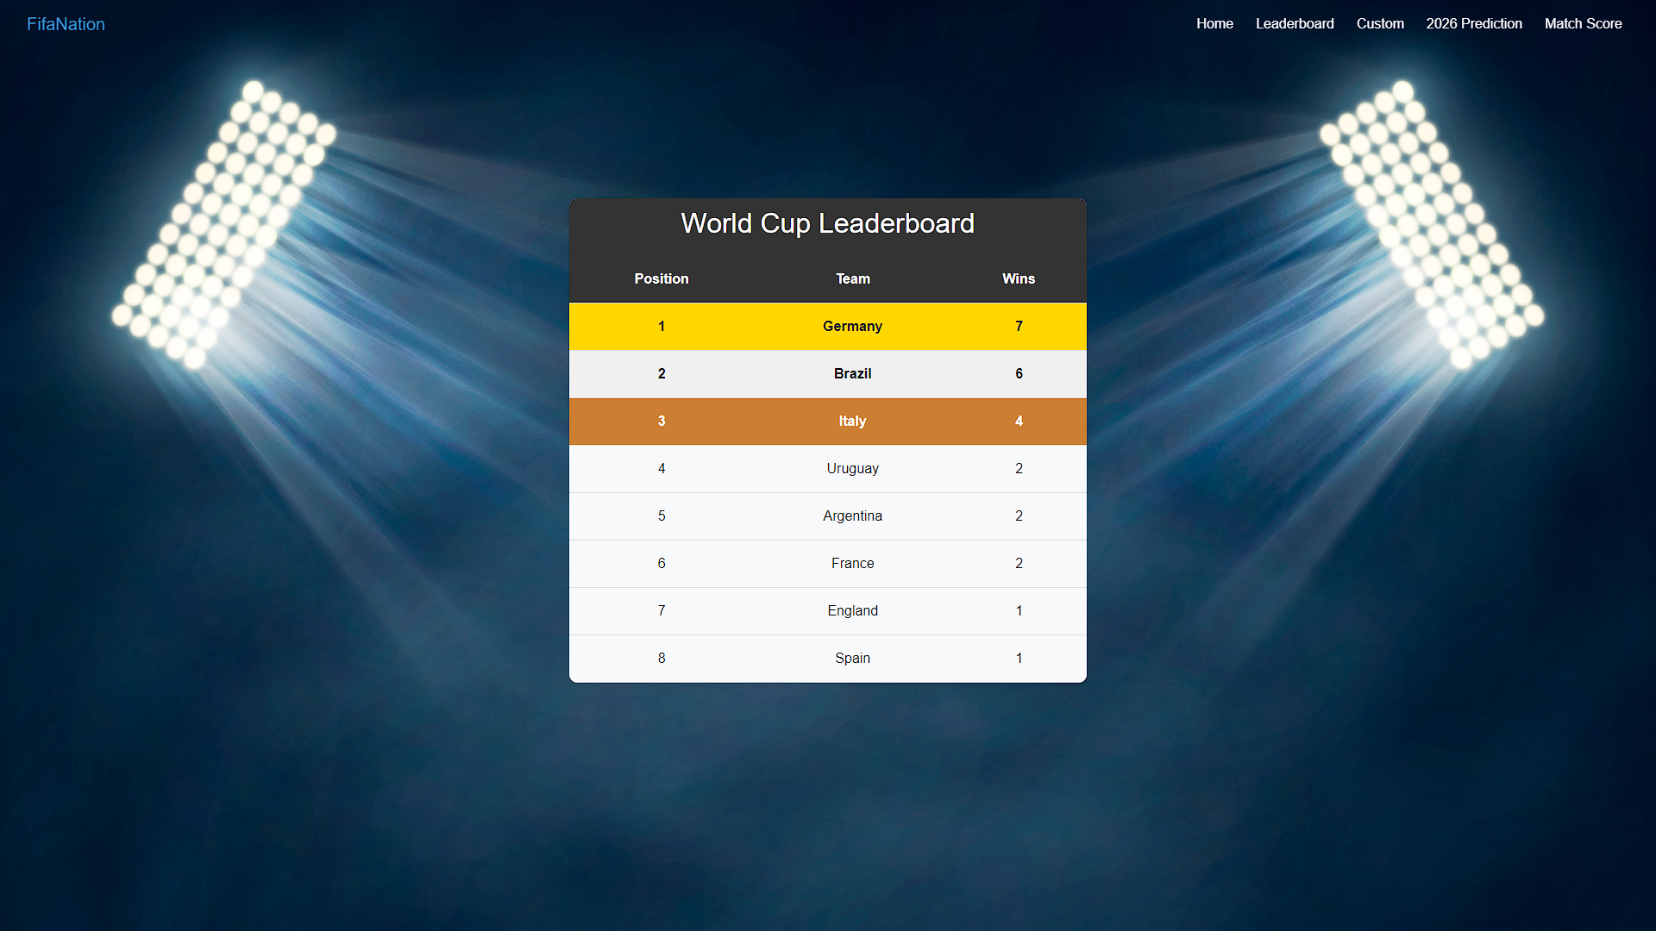

Slide 30
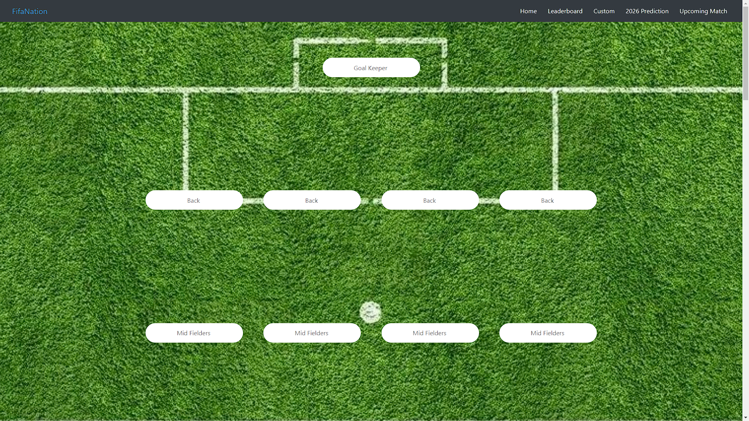
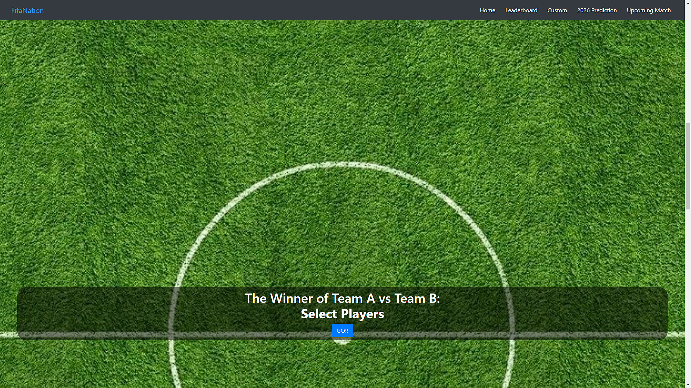
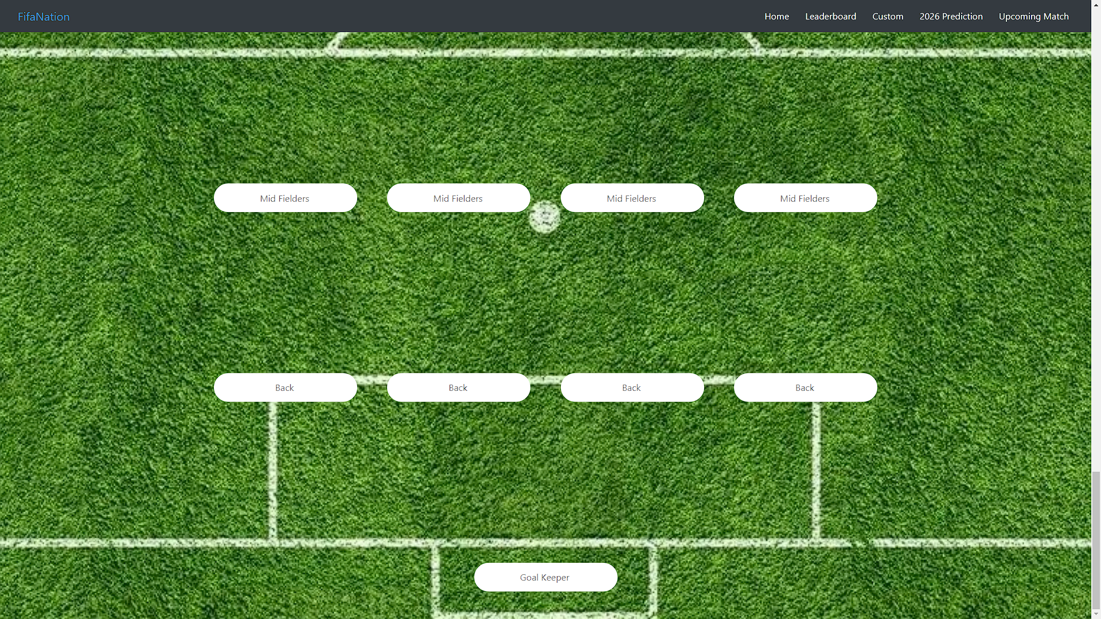

Slide 33

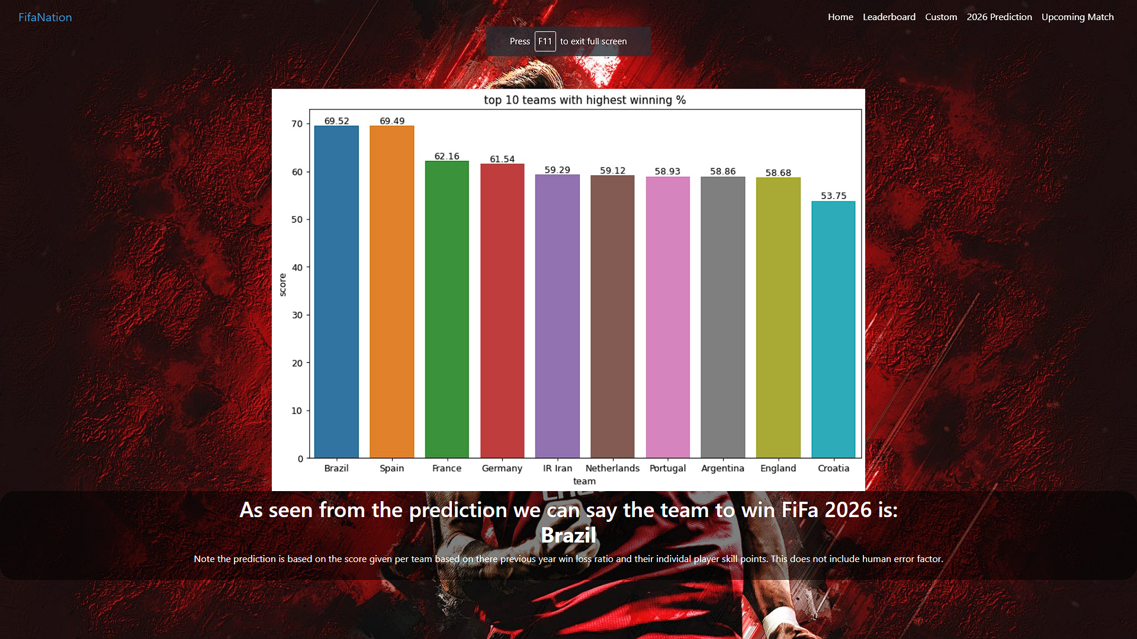

Slide 34
PROJECT AT
A GLANCE

Slide 35

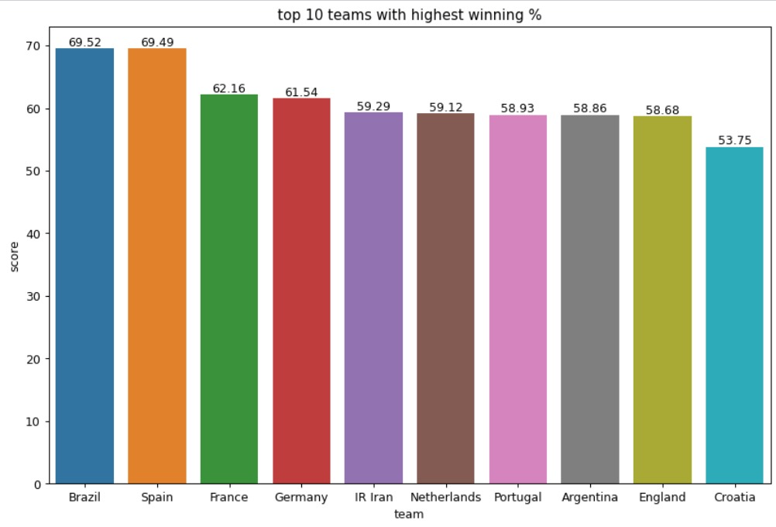

Slide 36
THE MODEL HAS AN ACCURACY OF 75% AND DOES NOT INCLUDE A FEW HUMAN FACTORS SUCH AS ILLNESS.
BRAZIL WINS!!!

Slide 37
BRAZIL WINS!!!
THE MODEL HAS AN ACCURACY OF 75% AND DOES NOT INCLUDE A FEW HUMAN FACTORS SUCH AS ILLNESS.

Slide 38

THANK YOU !!!!!!

